Slide 1
Employee Data Analysis
By using SQL and Tableau

Slide 2
Task 1:- Create a visualization that provides a breakdown between the male and female employees working in the company each year, starting from 1990.
SQL Query
SELECT
YEAR(d.from_date) AS calendar_year, e.gender, COUNT(e.emp_no) AS num_of_employees
FROM t_employees e JOIN t_dept_emp d ON d.emp_no = e.emp_no
GROUP BY calendar_year , e.gender
HAVING calendar_year >= 1990;

Slide 3
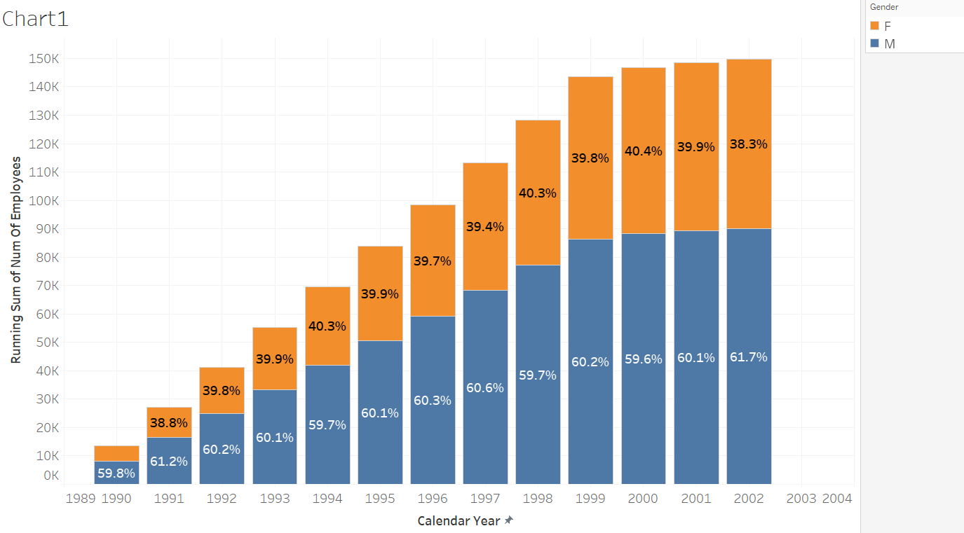

Slide 4
Task2:- Compare the number of male managers to the number of female managers from different departments for each year, starting from 1990.
SQL Query
SELECT d.dept_name, ee.gender, dm.emp_no, dm.from_date, dm.to_date, e.calendar_year, CASE WHEN YEAR(dm.to_date) >= e.calendar_year AND YEAR(dm.from_date) <= e.calendar_year THEN 1 ELSE 0 END AS active FROM (SELECT YEAR(hire_date) AS calendar_year FROM t_employees GROUP BY calendar_year) e CROSS JOIN t_dept_manager dm JOIN t_departments d ON dm.dept_no = d.dept_no JOIN t_employees ee ON dm.emp_no = ee.emp_no ORDER BY dm.emp_no, calendar_year;

Slide 5
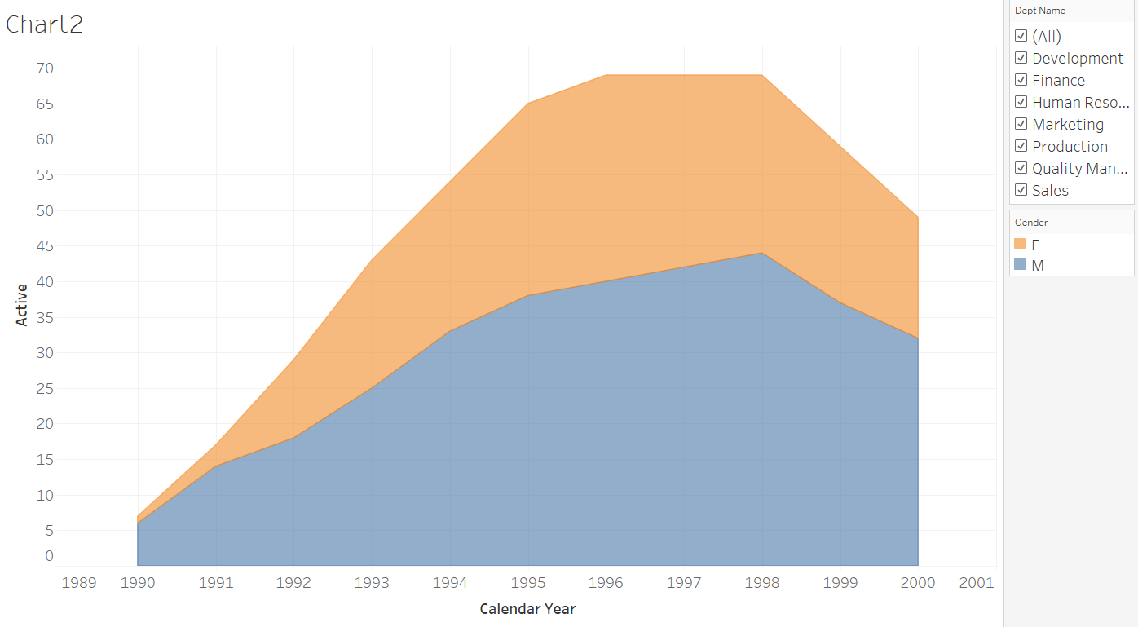

Slide 6
Task3:- Compare the average salary of female versus male employees in the entire company until year 2002, and add a filter allowing you to see that per each department.
SQL Query
SELECT e.gender, d.dept_name, ROUND(AVG(s.salary), 2) AS salary, YEAR(s.from_date) AS calendar_year FROM t_salaries s JOIN t_employees e ON s.emp_no = e.emp_no JOIN t_dept_emp de ON de.emp_no = e.emp_no JOIN t_departments d ON d.dept_no = de.dept_no GROUP BY d.dept_no , e.gender , calendar_year HAVING calendar_year <= 2002 ORDER BY d.dept_no;

Slide 7
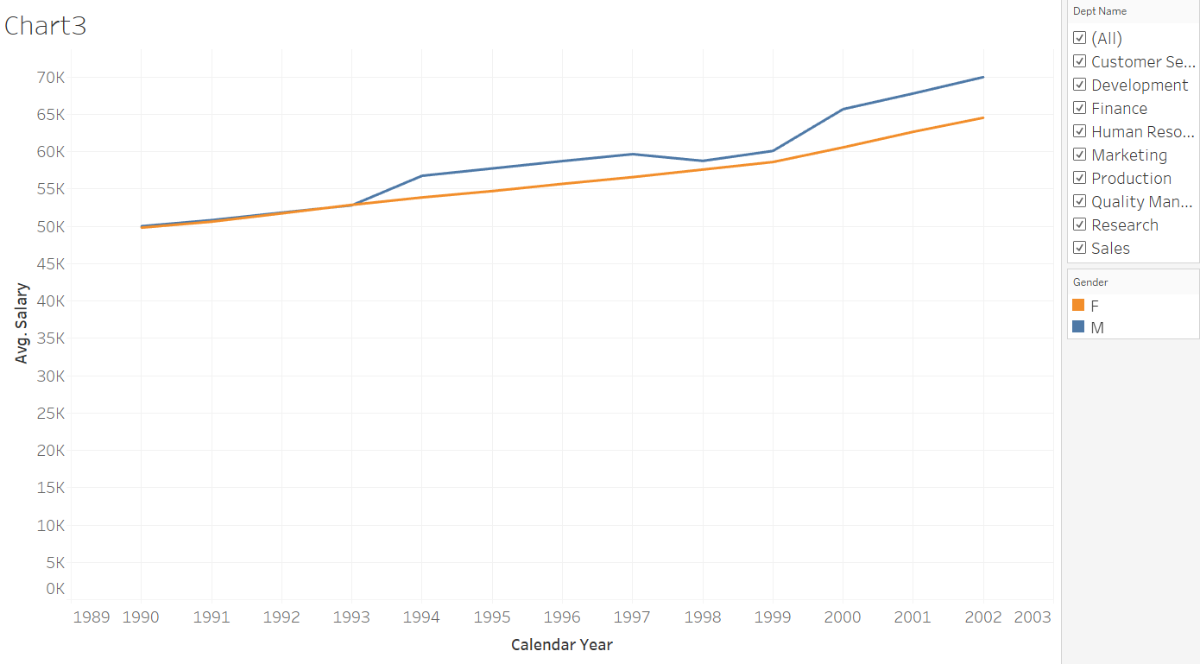

Slide 8
Task4:- Create an SQL stored procedure that will allow you to obtain the average male and female salary per department within a certain salary range. Let this range be defined by two values the user can insert when calling the procedure. Finally, visualize the obtained result-set in Tableau as a double bar chart.
SQL Query
DROP PROCEDURE IF EXISTS filter_salary; DELIMITER $$ CREATE PROCEDURE filter_salary (IN p_min_salary FLOAT, IN p_max_salary FLOAT) BEGIN SELECT e.gender, d.dept_name, AVG(s.salary) as avg_salary FROM t_salaries s JOIN t_employees e ON s.emp_no = e.emp_no JOIN t_dept_emp de ON de.emp_no = e.emp_no JOIN t_departments d ON d.dept_no = de.dept_no WHERE s.salary BETWEEN p_min_salary AND p_max_salary GROUP BY d.dept_no, e.gender; END$$ DELIMITER ; CALL filter_salary(50000, 90000);

Slide 9
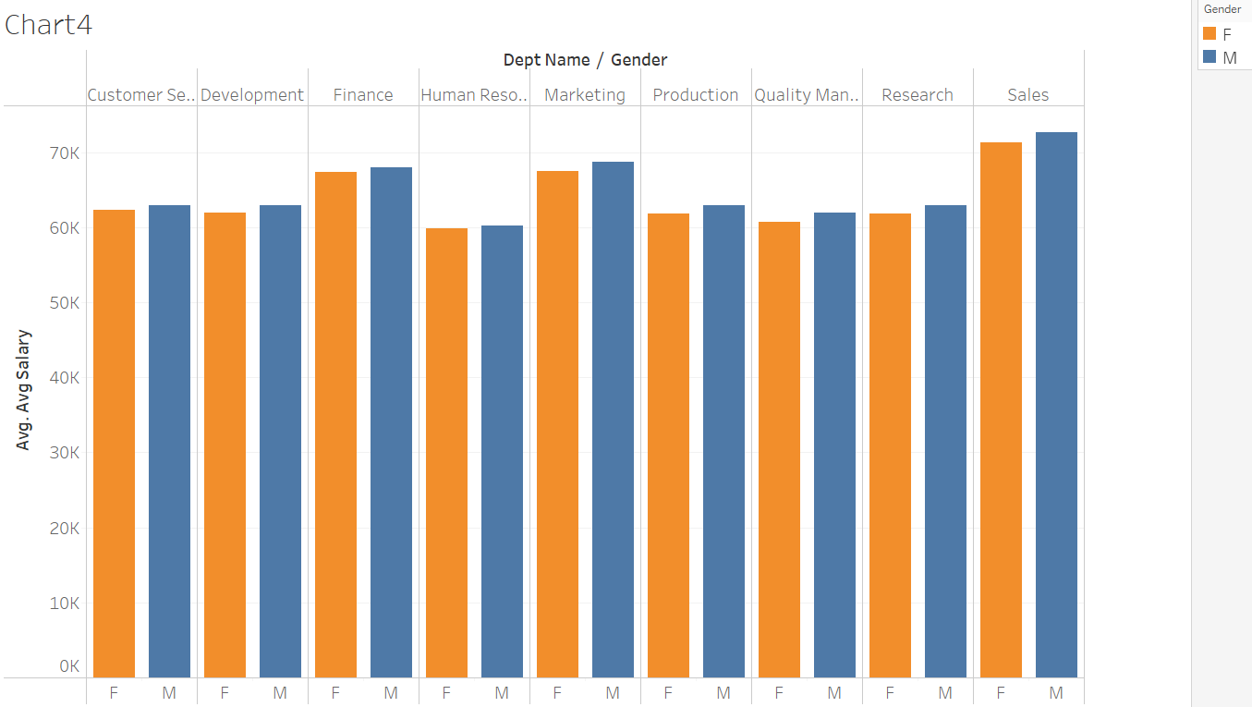

Slide 10
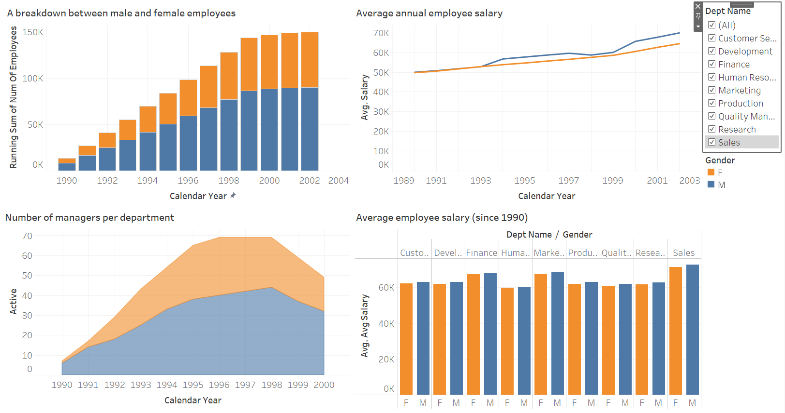
Summary

Slide 11
Thank You ☺
Vipin Chaudhary
iamvipin.it@gmail.com

